Slide 1


Salary Prediction
Using Linear Regression
Presented by Nanda Kishore Rana

Slide 2

Agenda
Overview of Presentation Contents
Introduction
Models Used
Tools & Technologies
Applications
Problems & Solutions
Future Scope
Project Link

Slide 3

Introduction to the Project
01
Problem Statement
The project aims to tackle the challenge of accurately predicting annual salaries based on various skills and experience levels.
02
Dataset Description
The dataset comprises diverse features, including job roles, experience, and skill levels, to ensure comprehensive salary predictions.
03
Target Variable
The target variable for prediction is the annual salary which serves as the main output of the models utilized.

Slide 4
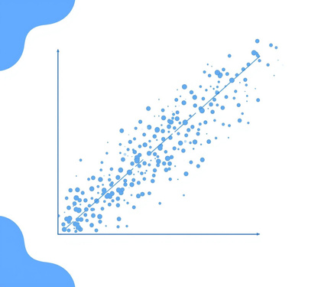



Machine Learning Models for Salary Prediction
Linear Regression
Random Forest
Gradient Boosting
Voting Ensemble
Linear Regression predicts salaries using a linear trend.
Random Forest improves accuracy through ensemble learning techniques.
Gradient Boosting enhances predictions by focusing on errors.
Voting Ensemble combines multiple models for final predictions.

Slide 5

Tools & Technologies
Essential tools for development
numpy
pandas
matplotlib
scikit-learn
VS Code
Streamlit

Slide 6
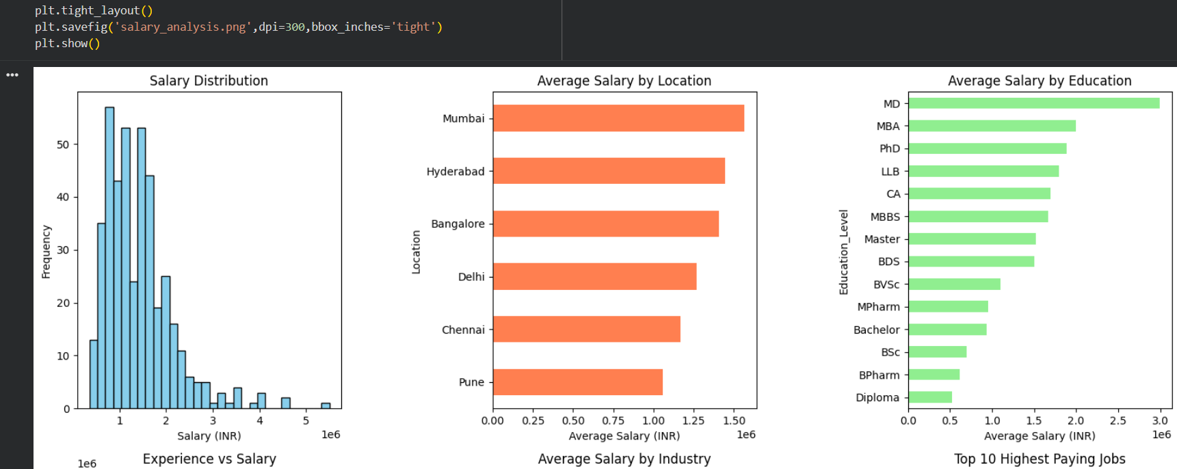
Output Screenshot 1

Slide 7
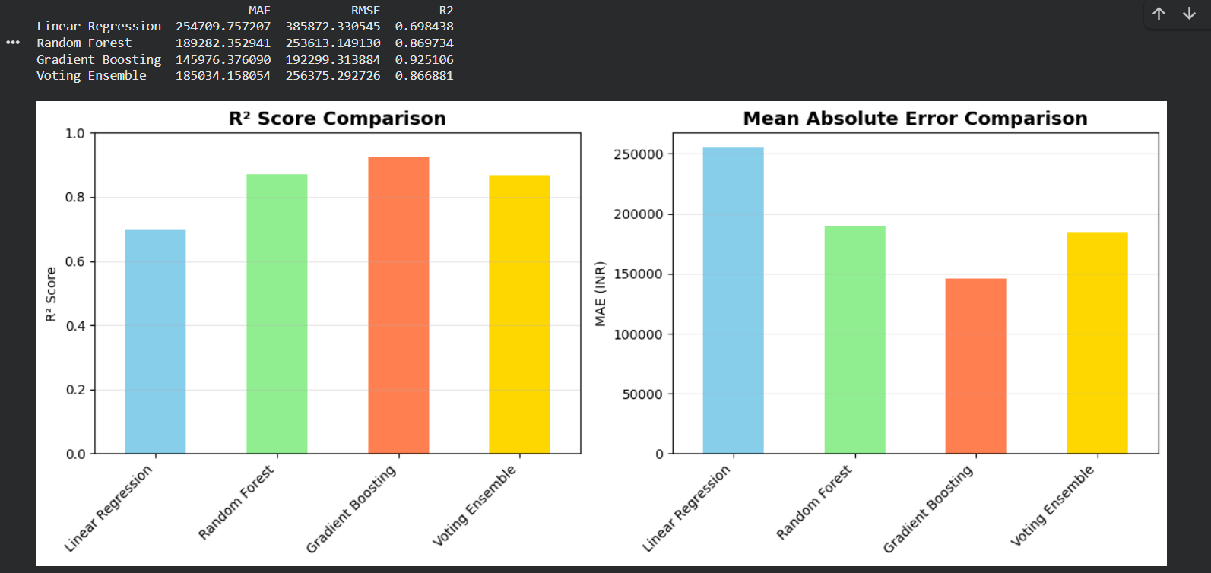
Code Output Screenshot

Slide 8

Applications of Salary Prediction
01
Job Market Analysis
Salary prediction models provide insights into industry standards and trends for effective workforce planning.
02
HR Compensation Planning
Organizations can use salary predictions to create fair compensation structures, ensuring competitive pay based on market data.
03
Candidate Salary Estimation
Accurate salary predictions assist recruiters in providing realistic salary ranges to attract the best talent and make informed offers.

Slide 9
Challenges Encountered & Resolved
Data Preprocessing Issues
Encoding Challenges
Data preprocessing involved handling incomplete records and outliers that skewed results, requiring meticulous cleaning techniques to ensure the dataset's reliability and accuracy for model training.
Encoding categorical features presented hurdles, necessitating the adoption of strategies like one-hot encoding and label encoding to convert textual data into a format suitable for machine learning algorithms.

Slide 10

Important
Links
Github
nandakishorerana/Salary-Prediction-Using-Linear-Regression

